Slide 1
Hello and welcome
Pre-requisites:
To take part in the hands-on component, you would need to create an account on GitHub and install Git/GitHub Desktop on your device.
For a guide on installation, refer to the Google Docs via
https://tinyurl.com/cbngh101
We will begin at 9.05pm

Slide 2
GitHub 101

Slide 3

Hello!
I am Jeffrey
Current Year 4, doing Final-Year-Internship
You can find me at @jeffreytjs

Slide 4
Content
1. (Theory) What is Git, GitHub and some simple use cases
2. (Practical) Walkthrough and demo of uploading existing projects onto personal GitHub account
3. (Theory) Deeper dive into collaboration on GitHub
4. (Optional Practical) Run-through on creation of Pull Requests (PRs) and resolution of merge conflicts

Slide 5
What is Git?
Git is a version control software. Git uses the command line to perform more advanced actions.
Notes:
What is version control? Version control allows you to keep track of your work and helps you to easily explore the changes you have made, be it data, coding scripts, notes, etc. As the number of changes start to increase, it gets harder and harder to keep track of where exactly you edited.

Slide 6
What is GitHub?
GitHub is an online platform to store your files in the cloud. Kind of like Google Drive.
Notes:
Where you can store your own files and share them with people if you want to. You can also collaborate with other people on a common project.

Slide 7
GitHub Use Cases
Primarily for version control
Showcase personal projects
Collaboration with others including recipes, music scores, books, tutorials and data sets.

Slide 8
Workflow
Commit
After saving your files locally, you have to commit them to save them as an “update”. You can make as many commits as necessary, it’s good practice to keep commits small.
Push
After committing your changes, it’s time to push them up to the cloud! Now both your local files and remote files are in sync.
Pull *Usually not needed if working individually
When there are changes made to the remote files, you can pull the changes instead of manually editing each local file. When collaborating with others, it’s always advised to pull before you make changes and also right before you push to resolve conflicts.

Slide 9
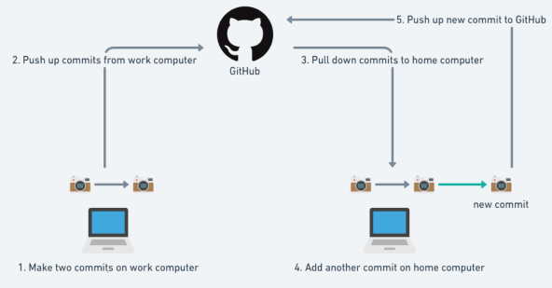
Workflow (With visuals)

Slide 10
Walkthrough + Hands-on
Part 1 (No coding/CLI knowledge required)
Create a repository
Upload an existing project to showcase

Slide 11
What is Branching?
Branches allow you to work on different versions of your repo at one time. Can move back and forth whenever you need.
Notes:
Usually when you want to work on a separate component, like a bug fix or a different feature. You can imagine it like writing a research paper, you can create a branch for writing methods and one for the conclusion.

Slide 12
What is Merging?
Merging is when you want to combining work done on different branches into one.
Conflict arises when there are overlapping changes.

Slide 13
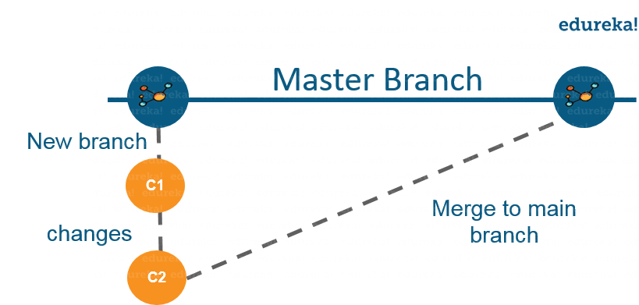
Branching + Merging
Notes:
As depicted in the above image, there is a master branch which has a new branch for testing. Under this branch, two set of changes are done and once it completed, it is merged back to the master branch. So this is how branching works!

Slide 14
Runthrough
Part 2 (No coding/CLI knowledge required)
Make commits in a new branch
Making a Pull Request
Merge + Resolving conflicts
Viewing commit history GitHub

Slide 15
What is Cloning?
Cloning is when you want to work on a repository available on GitHub. Directly copy an entire project by cloning or downloading.

Slide 16
What is Forking?
Forking is when you want to build on top of a project on your own account.
Notes:
To note:
Changes done to the original repository will be reflected back to the forked repository.
If you make a change in forked repository, it will not be reflected to the original repository until and unless you have made a pull request.
As soon as you click on “Fork”, it will take some time to fork the repository. Once done you will notice that the repository name is under your account.

Slide 17
Runthrough + Hands-on
Part 2 (As seen earlier)
Make commits in a new branch
Making a Pull Request
Merge + Resolving conflicts
Viewing commit history GitHub
Part 3 (Good to know about CLI)
Forking a repo
Cloning a repo to work locally
Part 2 on local IDE
Committing new changes and making a push
Part 2

Slide 18
That’s all folks.
Don’t worry if you can’t quite follow through, it’s a lot to take in. The next time you revisit them, they won’t be foreign to you anymore.

Slide 19
More resources…
https://nus-cs2103-ay2021s2.github.io/website/se-book-adapted/chapters/gitAndGithub.html
https://docs.microsoft.com/en-us/azure/devops/learn/git/what-is-git
https://guides.github.com/activities/hello-world/
https://zeddrix.com/lesson-24-how-to-use-your-github-desktop/
https://learngitbranching.js.org/
https://rubygarage.org/blog/most-basic-git-commands-with-examples

Slide 20
Credits
Special thanks to these people:
Presentation template by SlidesCarnival
Lesson flow and theory by OurCodingClub

